Slide 1




Music Style Transfer
IThub College
Dmitriy Volynov
Nikita Pestretsov
Gleb Kolonin
Alexander Dyakov

Slide 2
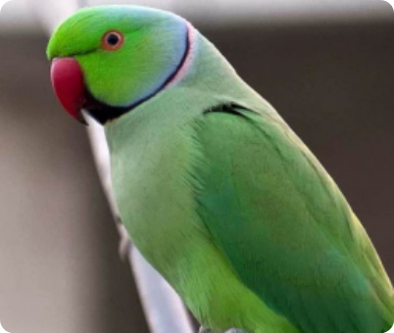
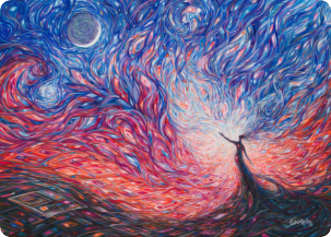
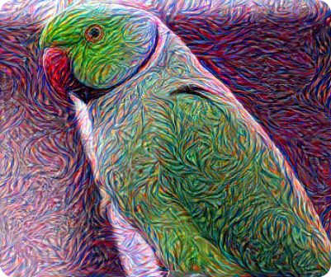
What is style transfer?
Content
Style
Result

Slide 3
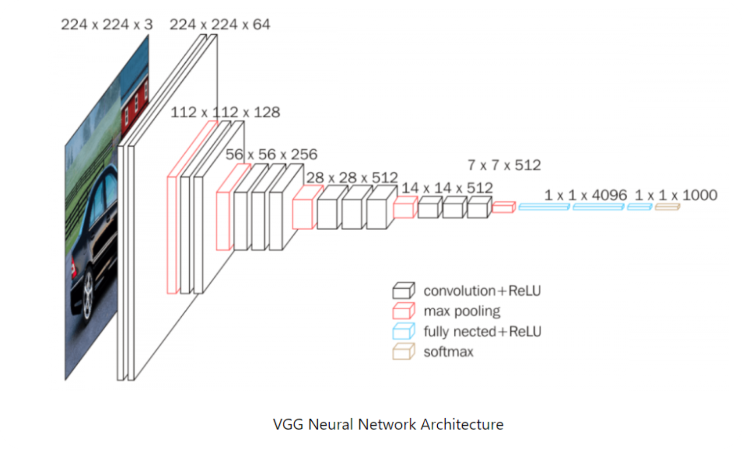
VGG-19

Slide 4


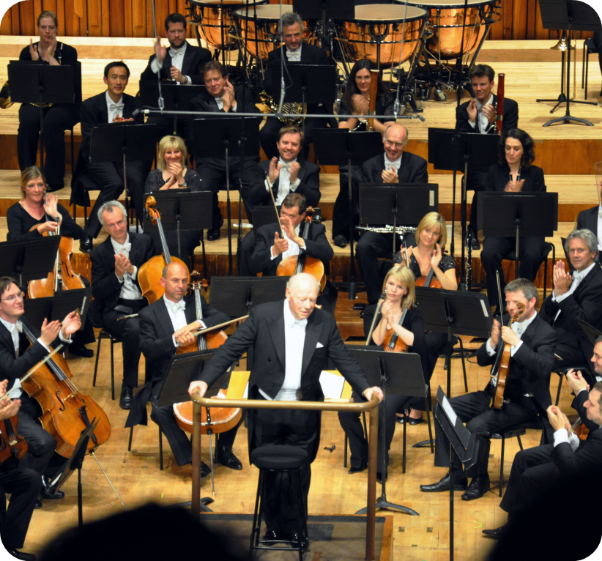
What is our idea?
?
Content
Style

Slide 5
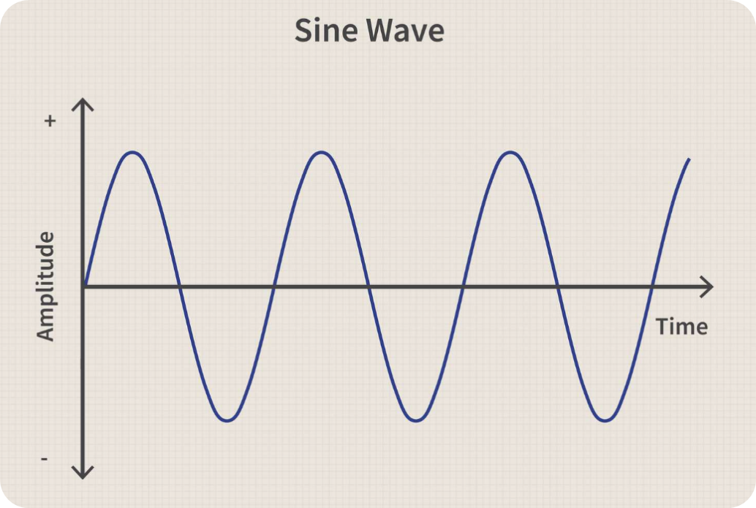

Sound as a wave

Slide 6
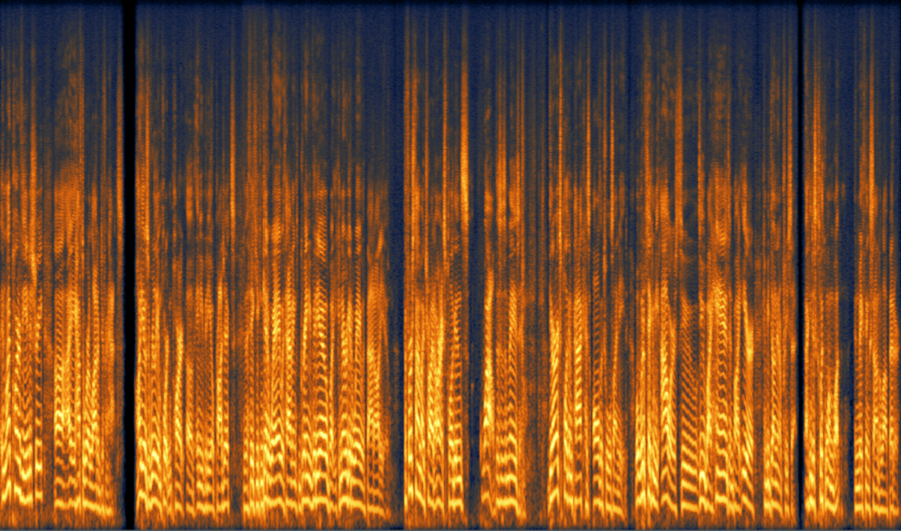
Spectrogram
y
frequency
time
x

Slide 7
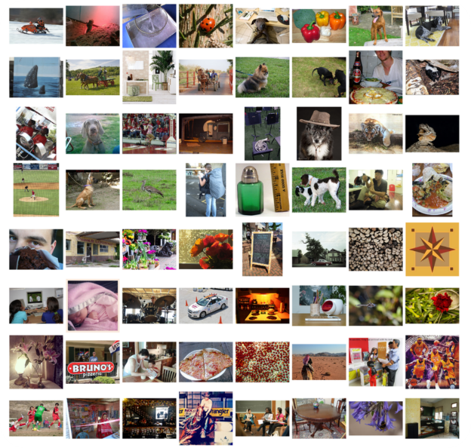
Not VGG-19

Slide 8
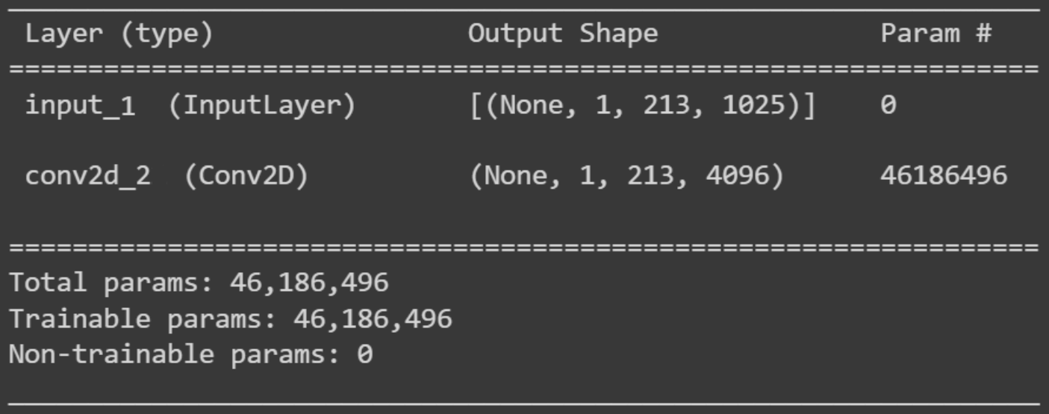
Our Network

Slide 9
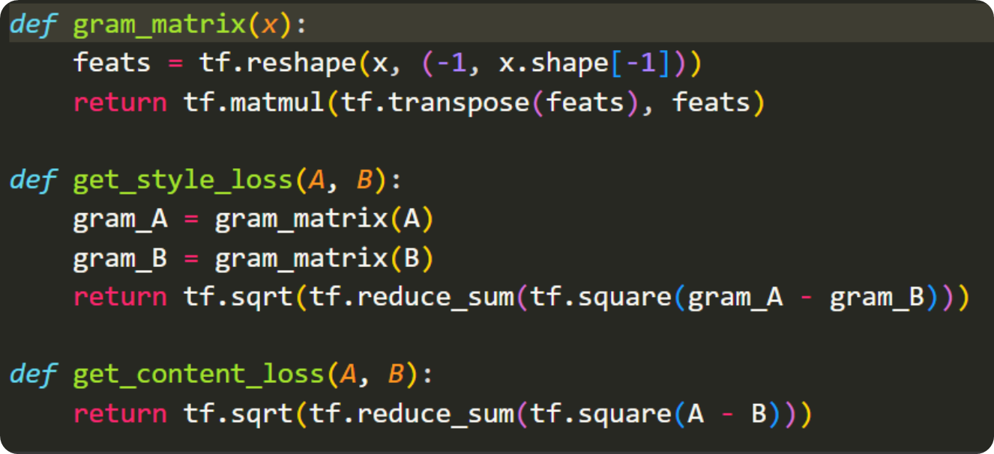
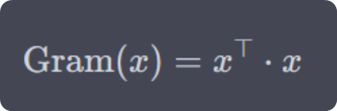
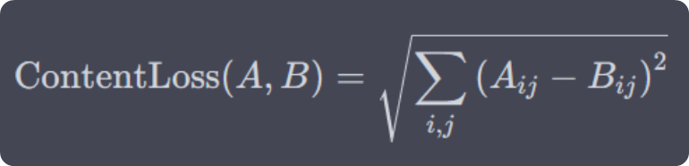
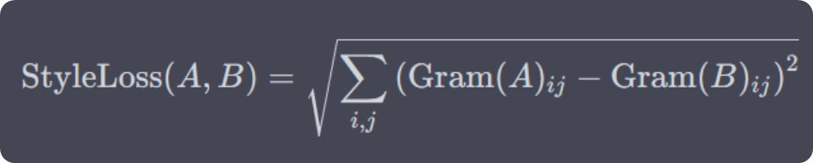
Losses

Slide 10
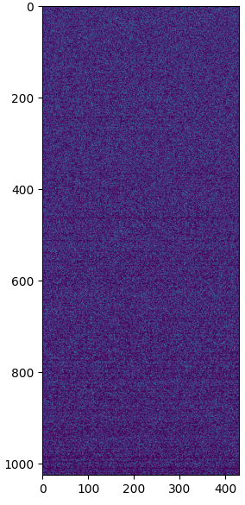
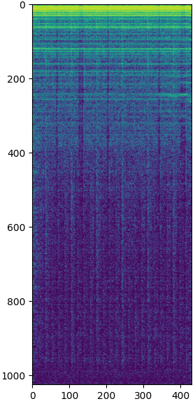
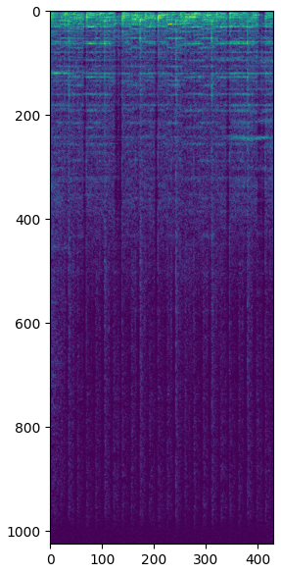


Training process
1 epoch
100 epochs
1000 epochs

Slide 11
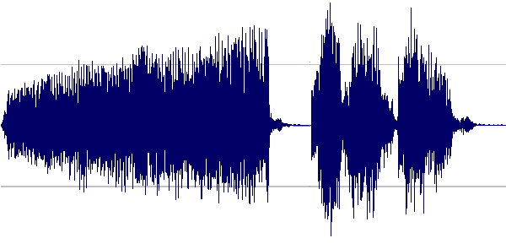
Griffin-Lim Algorithm + Inverse Fourier Transform

Slide 12
Results!

Slide 13

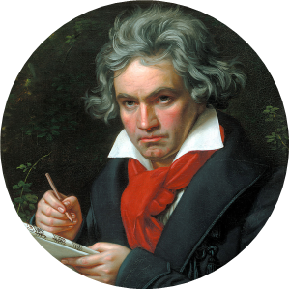
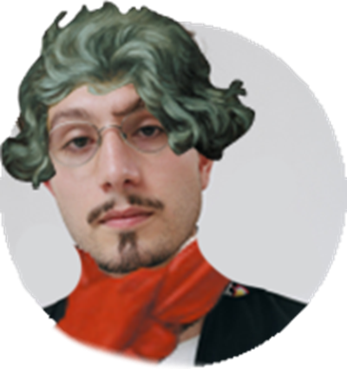
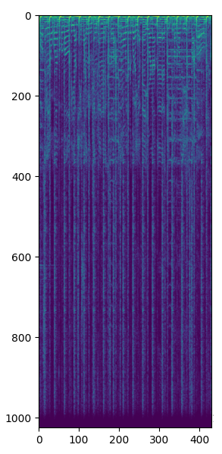
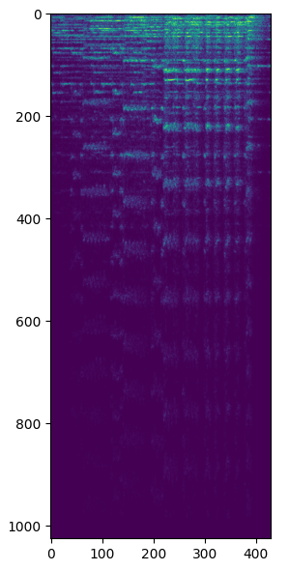
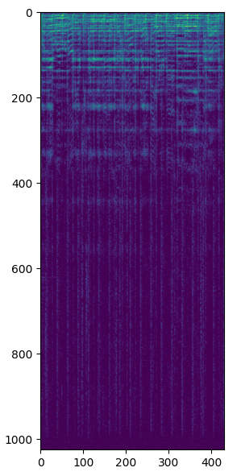

bbno$
Bethoven
Bbnohoven

Slide 14
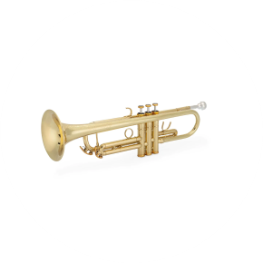
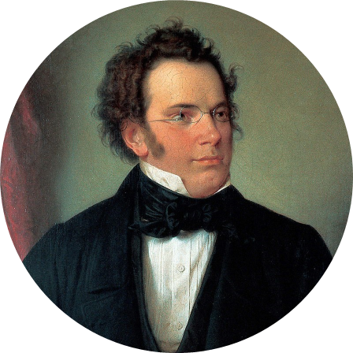
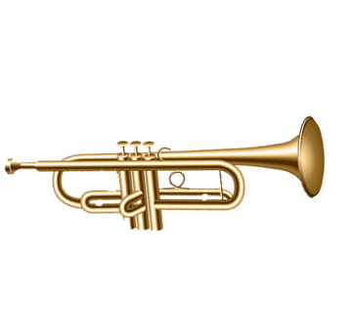
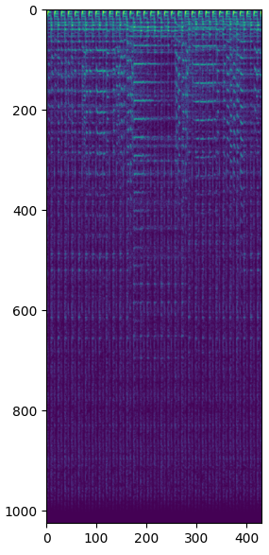
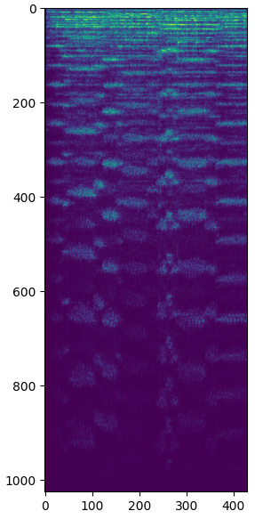
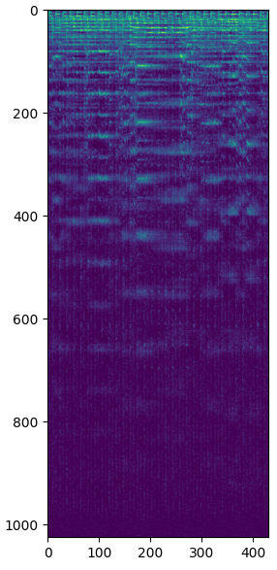
Moldovian Trumpet
Schubert
Trubert

Slide 15



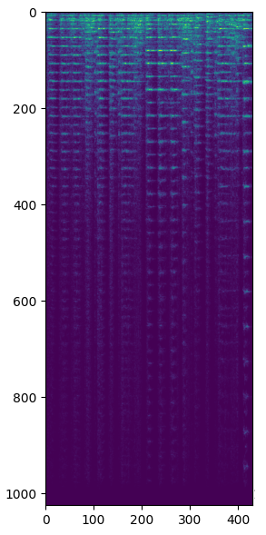
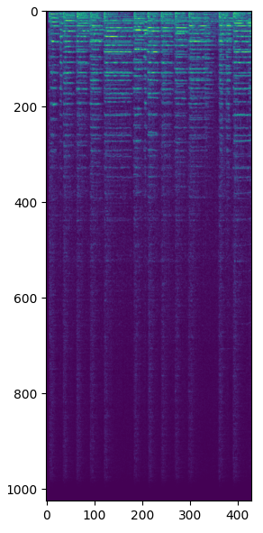
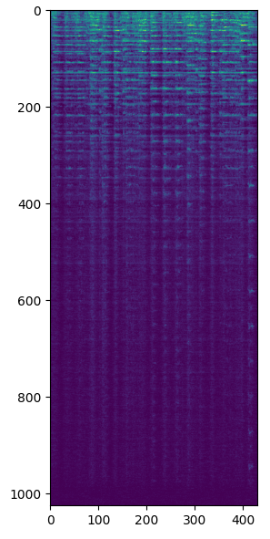
StarWars
USA Anthem
StarAnthem

Slide 16

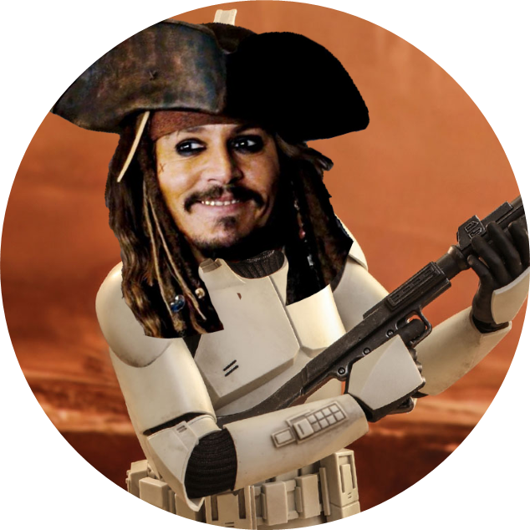
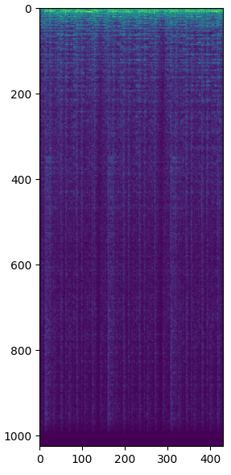
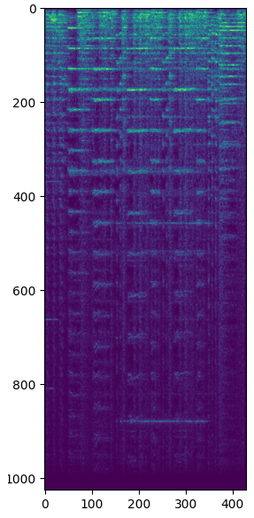
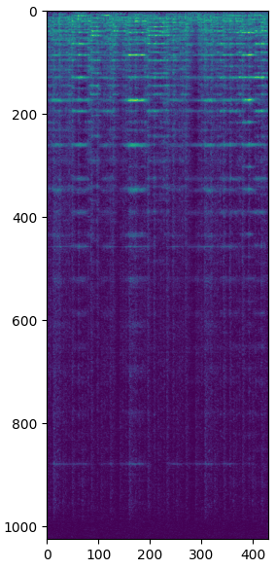
Pirates
StarWars
PiratWars

Slide 17
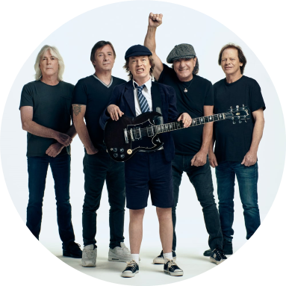
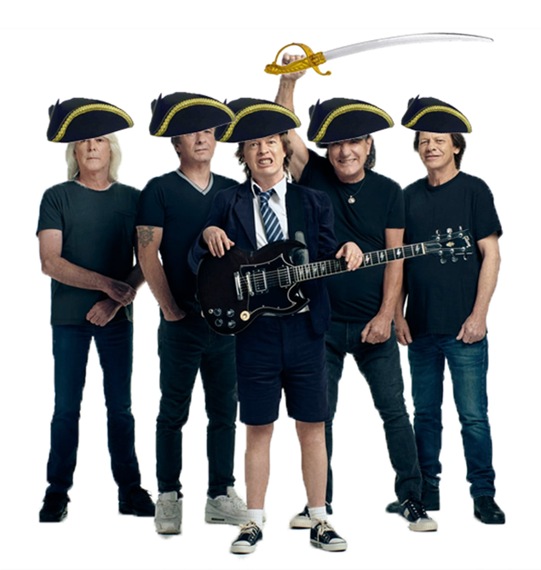
Pirates
AC/DC
Pirat/DC

Slide 18
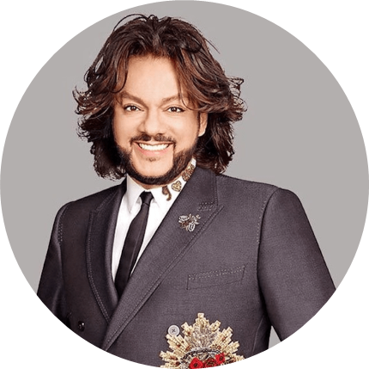
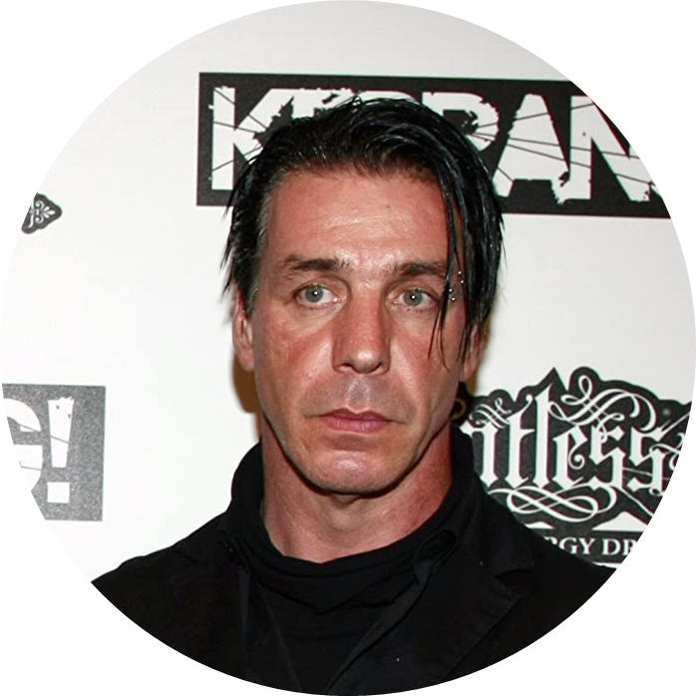
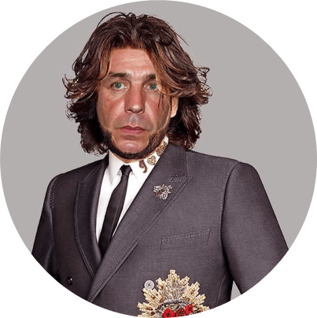
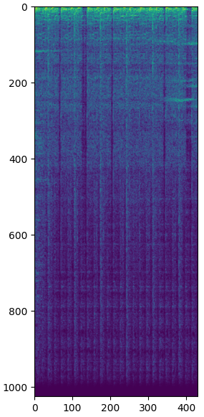
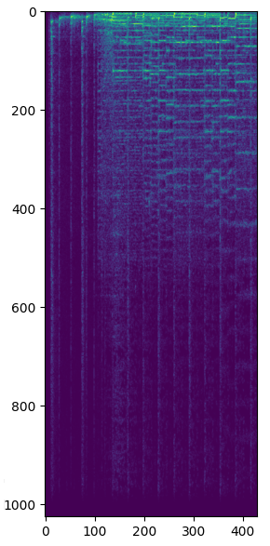
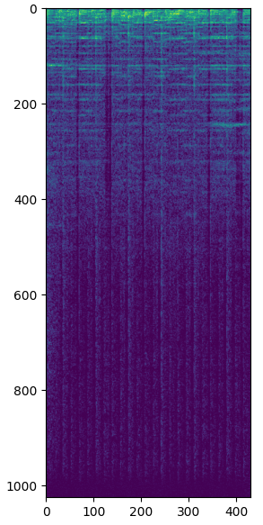
Kirkorov
Rammstein
Kirkostein

Slide 19

Links
Our project
https://arxiv.org/pdf/1606.00021.pdf
https://towardsdatascience.com/voice-translation-and-audio-style-transfer-with-gans-b63d58f61854
https://openreview.net/pdf?id=BybQ7zWCb
https://cs230.stanford.edu/projects_spring_2021/reports/76.pdf
https://github.com/DmitryUlyanov/neural-style-audio-torch
https://github.com/jcjohnson/neural-style
https://drive.google.com/file/d/1R43bJGd4bdqdJhUvCDQAvBQzD3J4w0mE/view?usp=sharing

Slide 20
Thank you for your time and attention 🙂

